Slide 1
The Battle of Neighborhoods
Capstone Project of Data science course
Deepak singh
July 18, 2021

Slide 2
1. Introduction
Toronto and New York are two famous big cities in Canada and US, respectively.
These two countries welcome millions of migrants every year.
In this project, we will use machine learning tools to cluster Toronto and New York neighborhoods in order to recommend the neighborhoods which are the best choices for migrants based on surrounded essential facilities such as school, hospital, and stores etc.

Slide 3
II. Data
City data are downloaded from URL
Toronto: https://cf-courses-data.s3.us.cloud-object-storage.appdomain.cloud/IBMDeveloperSkillsNetwork-DS0701EN-SkillsNetwork/labs_v1/Geospatial_Coordinates.csv
New York: https://cf-courses-data.s3.us.cloud-object-storage.appdomain.cloud/IBMDeveloperSkillsNetwork-DS0701EN-SkillsNetwork/labs/newyork_data.json

Slide 4
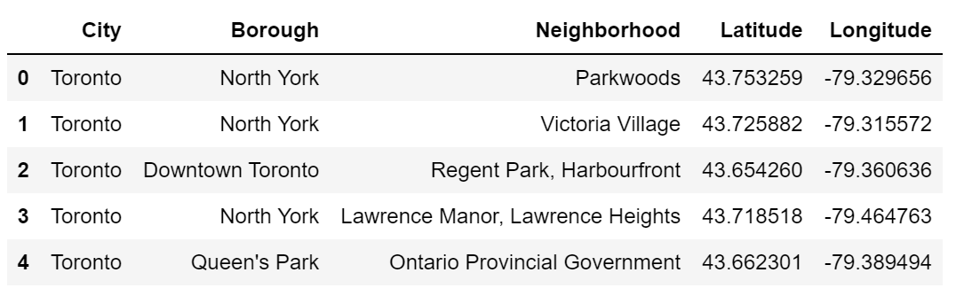
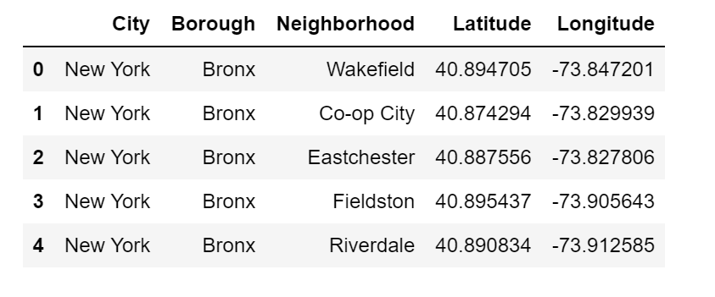
Datasets are displayed below:
Toronto’s Data
New York’s Data

Slide 5
III. Methodology
Obtain coordinates of the combined DataFrame.
Data Visualization
Using Foursquare API calls to get venue information
Using Machine Learning Models – K-means Clustering

Slide 6
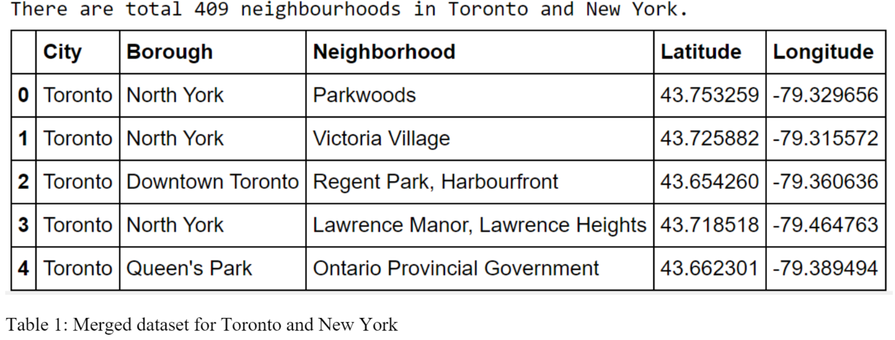
1. Coordinates of Neighborhoods

Slide 7
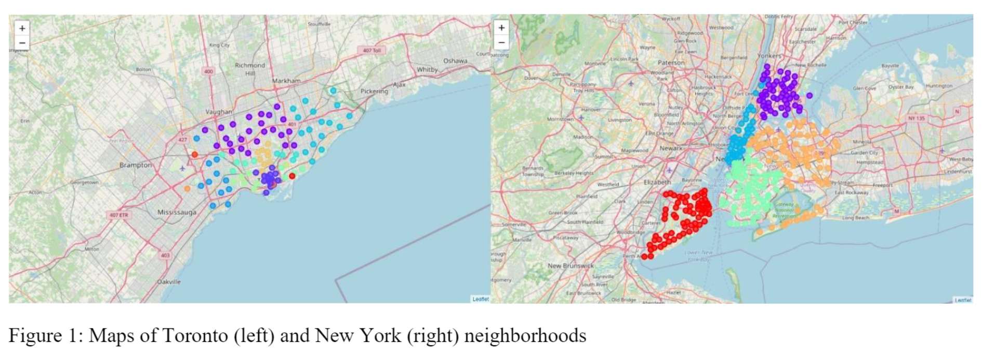
2. Data Visualization

Slide 8
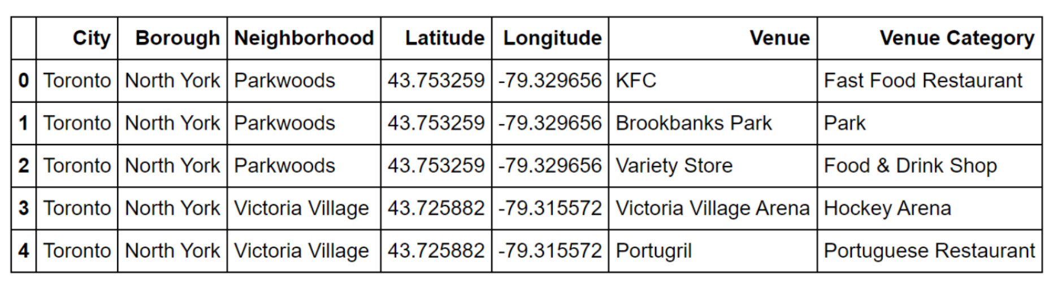
3. Venue information

Slide 9
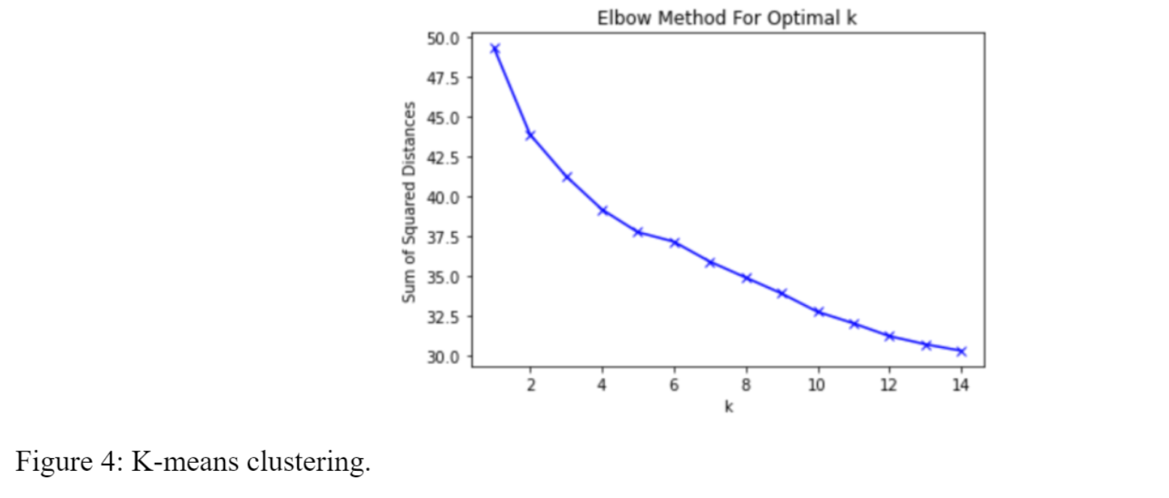
4. Machine Learning Models

Slide 10
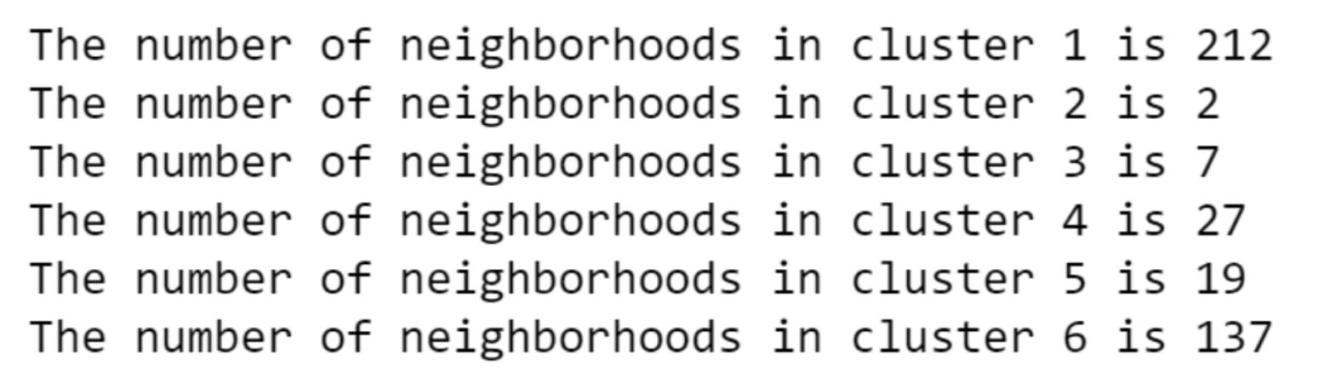
IV. Results
The results of K-means clustering shows that:

Slide 11
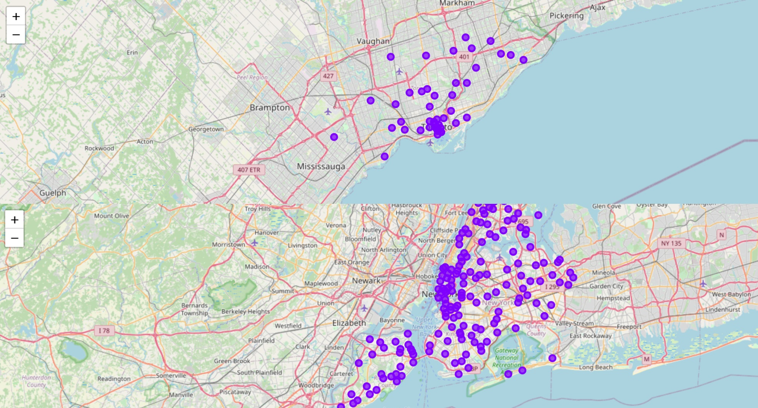
Cluster 1: Mainly restaurants and coffee shops
Toronto
New York

Slide 12
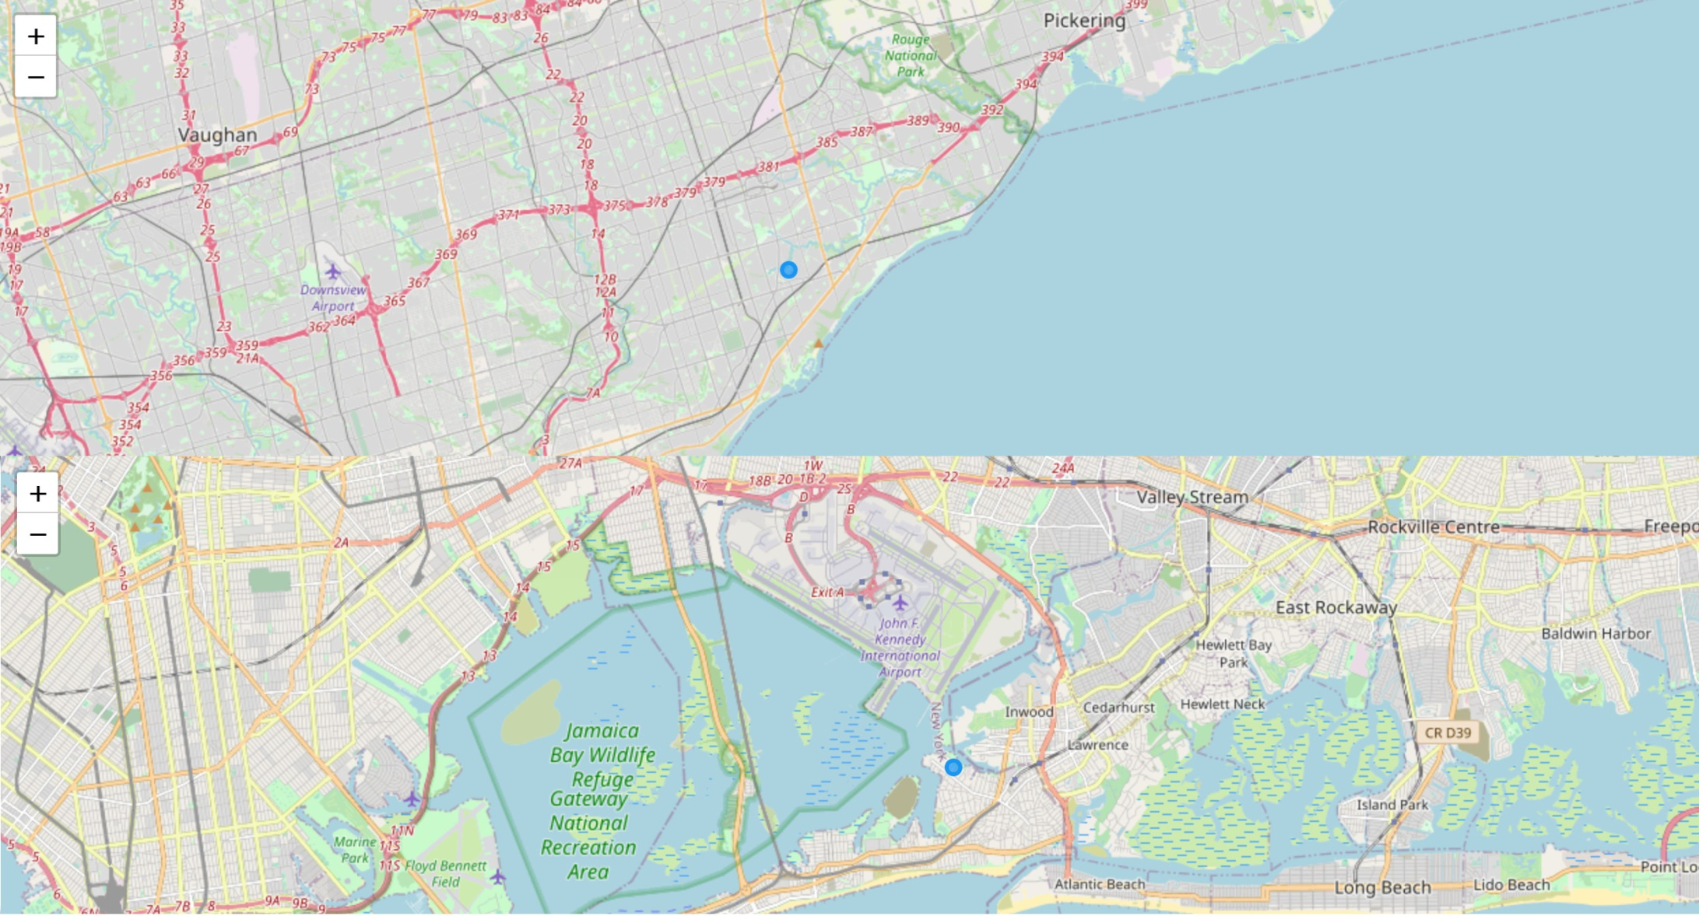
Cluster 2: Mainly playgrounds and yoga studios
Toronto
New York

Slide 13
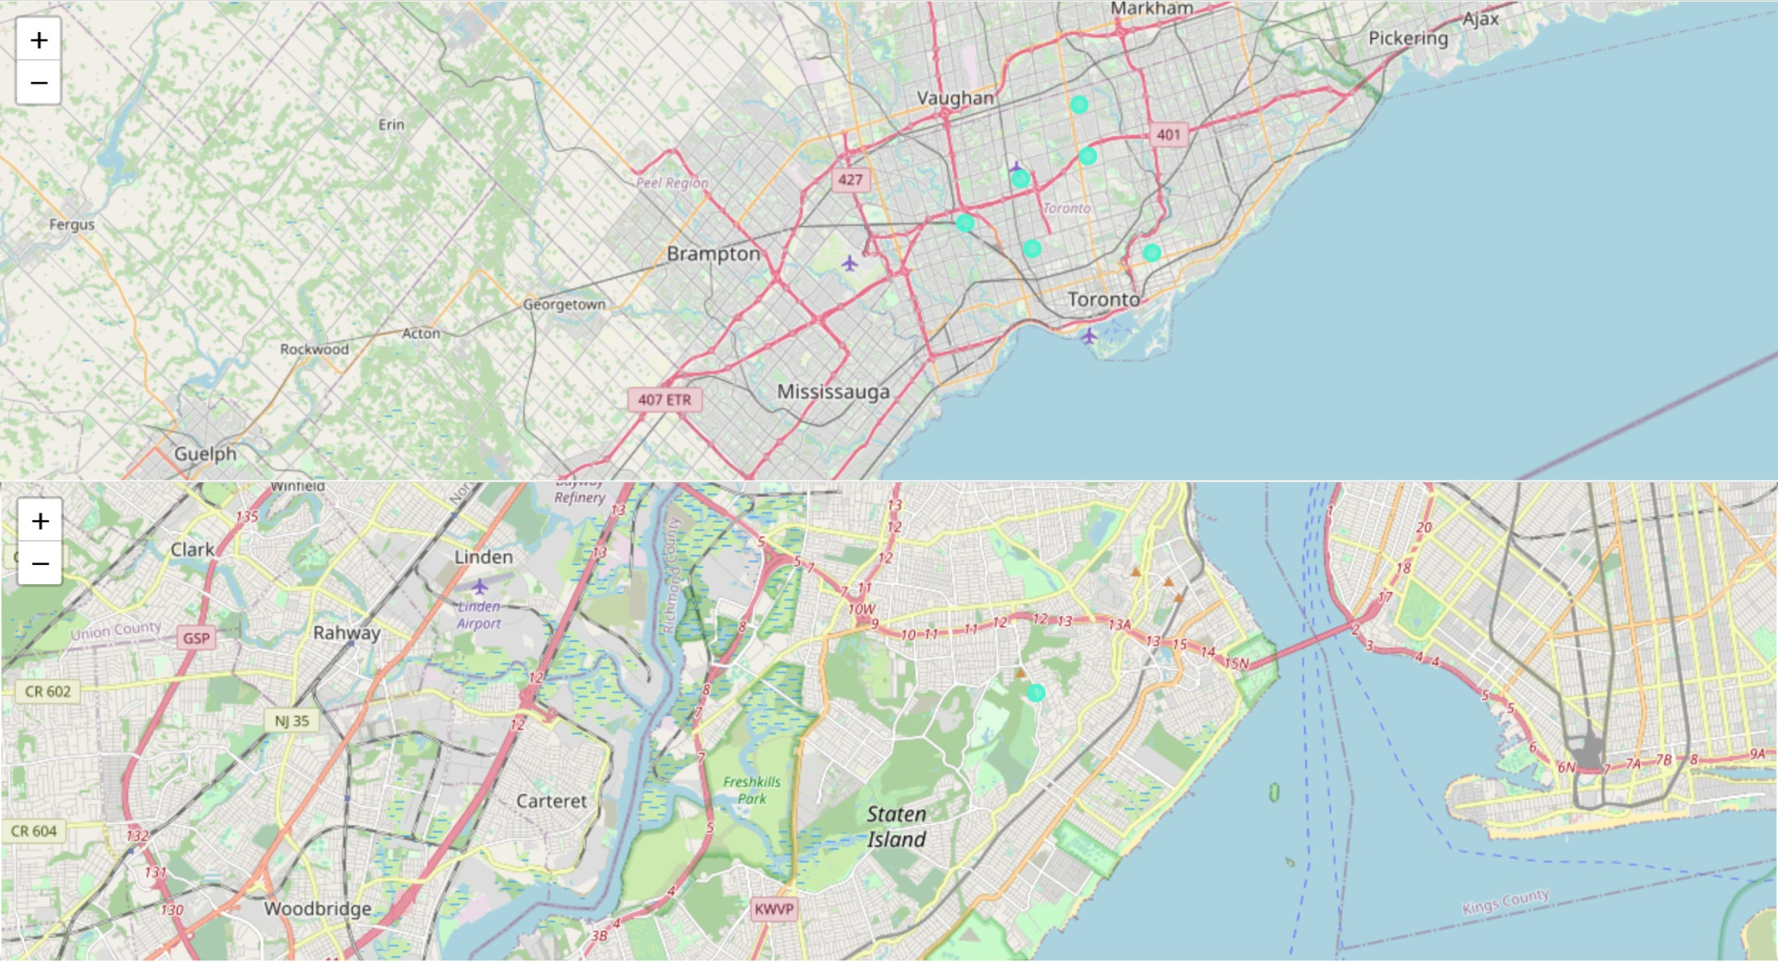
Cluster 3: Mainly parks and convenience stores
Toronto
New York

Slide 14
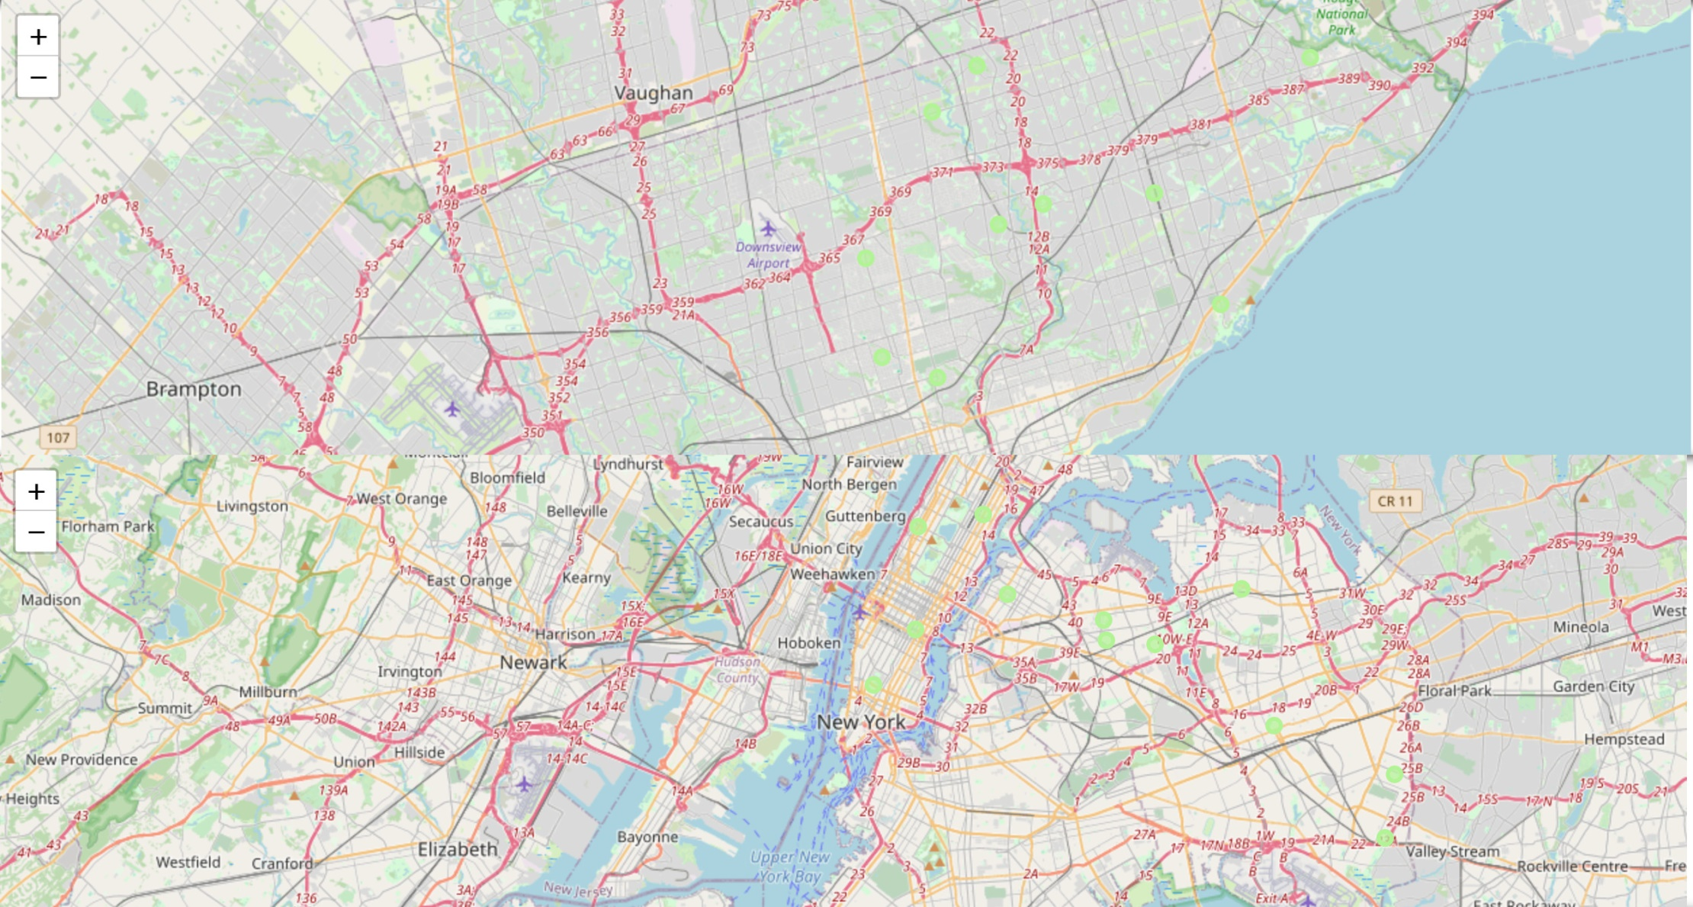
Cluster 4: Mainly restaurants and pizza/ice cream stores
Toronto
New York

Slide 15
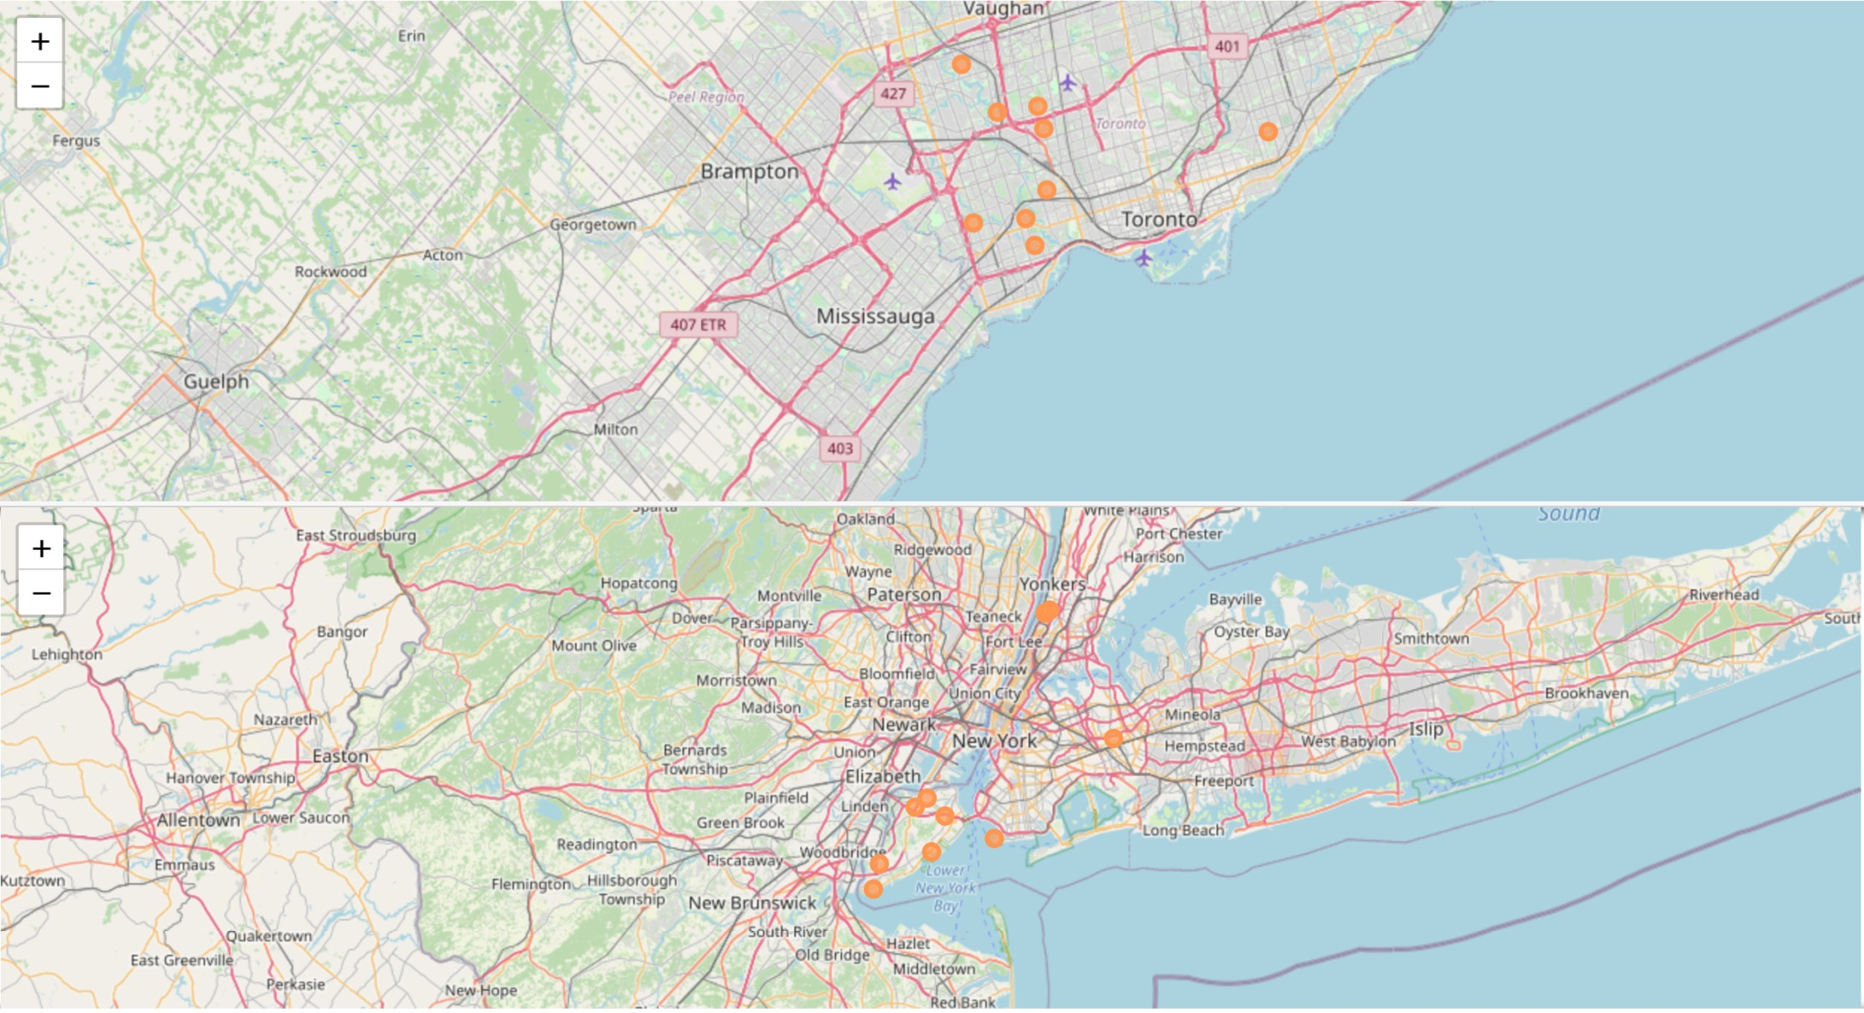
Cluster 5: Mainly grocery store, construction sites, and baseball playfields
Toronto
New York

Slide 16
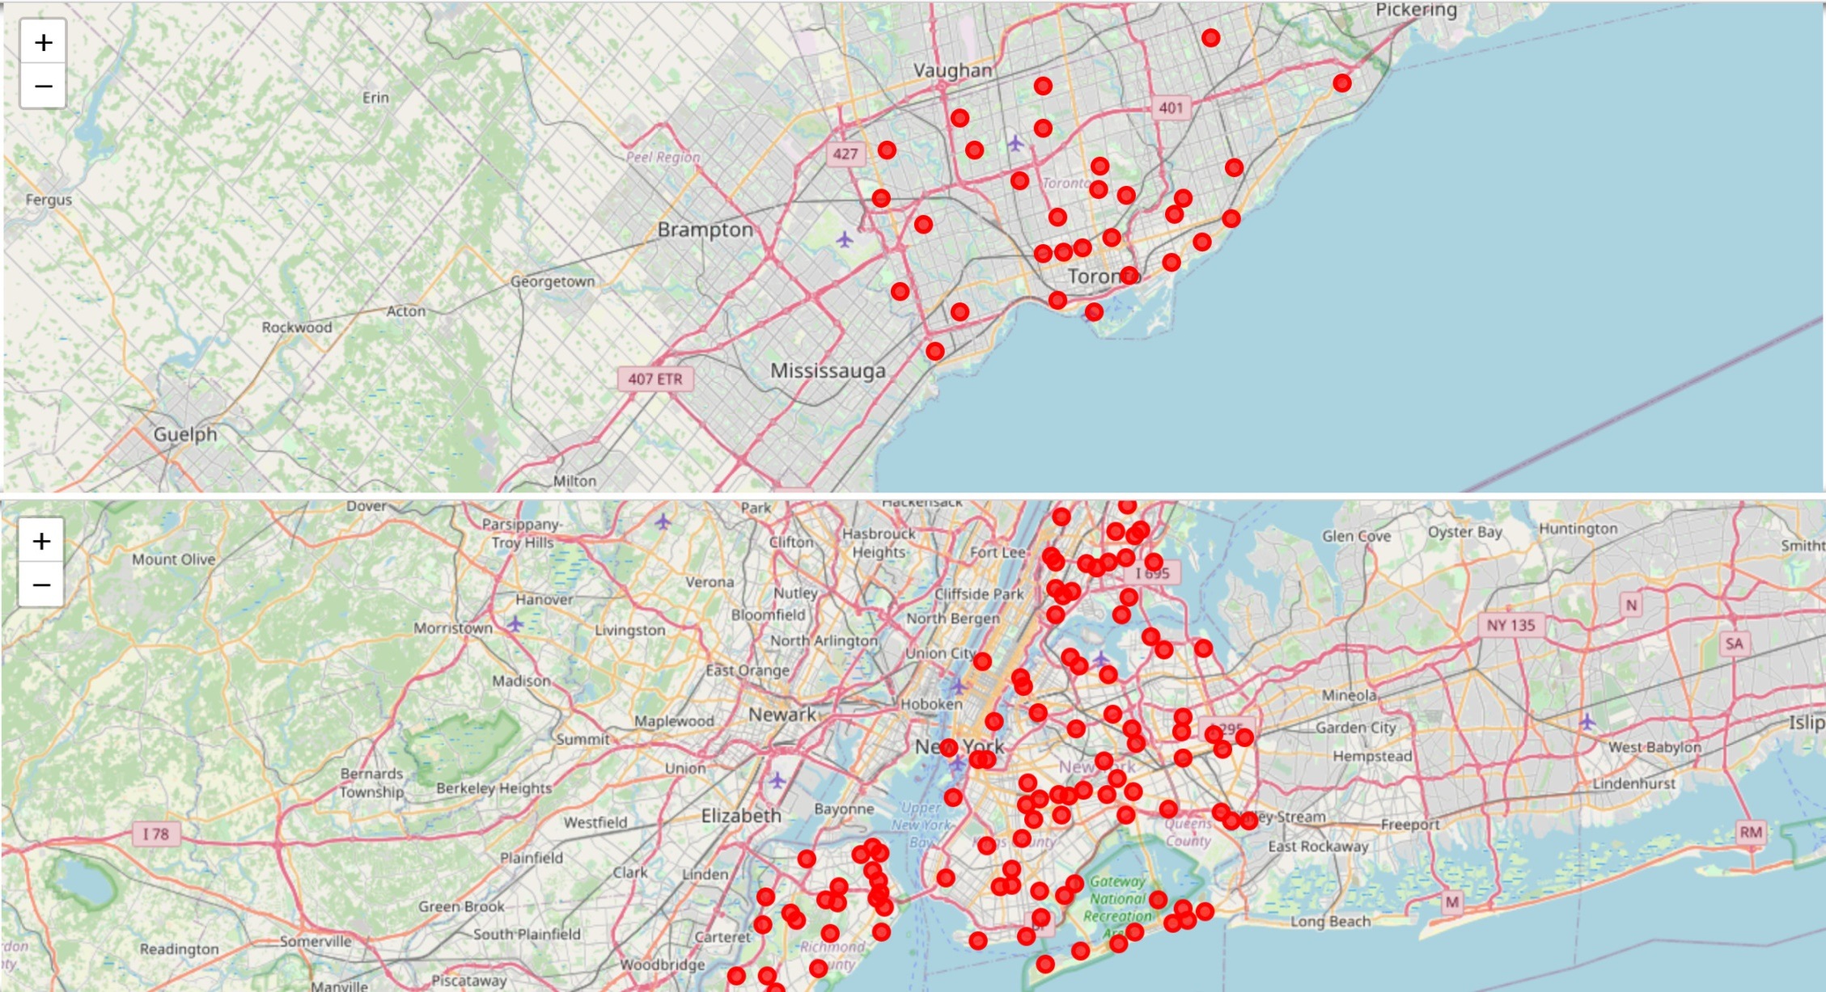
Cluster 6: Many different living essential stores and entertainment venues
Toronto
New York

Slide 17
V. Discussion
If one likes eating – choose cluster 1 or 4
If one likes parks – choose cluster 2 or 3
If one wants to live in a neighborhood with a lot of varieties of stores – choose cluster 6
If one prefers a leisurely lifestyle – choose Toronto
If one prefers a “crowded” neighborhood – choose New York

Slide 18
VI. Conclusion
This clustering model groups similar neighborhoods in two big cities – Toronto and New York, based on their nearby venues.
This recommendation system can be applied to any other two cities.
Hopefully, this analysis can help people who want to relocate make a decision on where to live at.

Slide 19
Thank you!

